Slide 1

Who’s Doing What for Whom, and How? The Social Media Analysis Solution Space
Seth Grimes
@sethgrimes

Slide 2

Deconstruction
The topic “Knowledge Extraction and Consolidation from Social Media” is comprised of:
Knowledge Extraction.
Knowledge Consolidation.
Social Media.
Sentiment, opinion mining, and analysis are involved.
I’ll talk about these matters.

Slide 3
Deconstruction, 2
My topic: Who’s Doing What for Whom?
Who = Solution providers: researchers, software, services.
What = Social media analysis (SMA), “social business,” analytics-infused advisory services.
For Whom = Business users.
How = Technologies.
I’ll talk about these elements as well, starting with the applications, then moving to tech, then to providers.

Slide 4
Theses
Social Media = Platforms + Networks + Content.
Knowledge = Contextualized, interrelated information.
Knowledge, in automated settings, must be structured to be usable .
Consolidation involves collection, filtering, analysis, reduction, integration, inference, and presentation… iteratively.
“Business is a collection of activities carried on for whatever purpose, be it science, technology, commerce, industry, law, government, defense, et cetera.”

Slide 5
Business Questions
What are people saying? What’s hot/trending?
What are they saying about {topic|person|product} X?
... about X versus {topic|person|product} Y?
How has opinion about X and Y evolved?
How has opinion correlated with {our|competitors’|general} {news|marketing|sales|events}?
What’s behind opinion, the root causes?
(How) Can we link opinions & transactions?
(How) Can we link opinion & intent?
Who are opinion leaders?
How does sentiment propagate across channels?

Slide 6
Business Needs
How do these factors affect my business?
How can answers to these questions help me improve business processes?
We have a decision support need and an operational need. We=
Consumers.
Marketers.
Competitors.
Managers.

Slide 7
Analysis Approaches
In industry settings, we (should) work backward: Mission ➔ Goals ➔ Presentation ➔ Methods & Data
What are your business goals?
What insights will help your reach them?
What data, transformation, and presentations will generate those insights?
For each option, what will it cost and what is it worth: What is the expected/projected ROI?
Sometimes we work this way, and sometimes we want to explore…

Slide 8
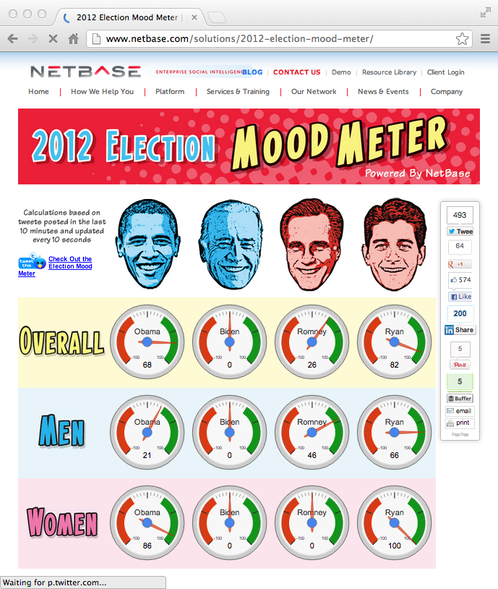
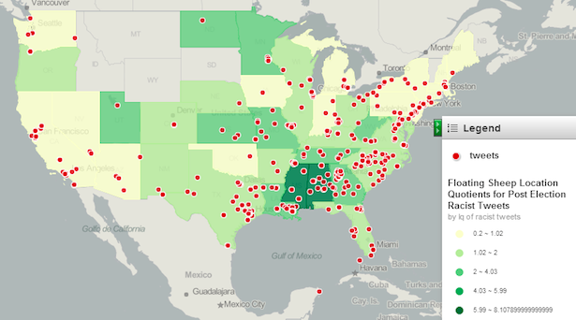
Data, Information & Knowledge
“Where America’s Racist Tweets Come From”
http://mashable.com/2012/11/11/racist-tweets/

Slide 9
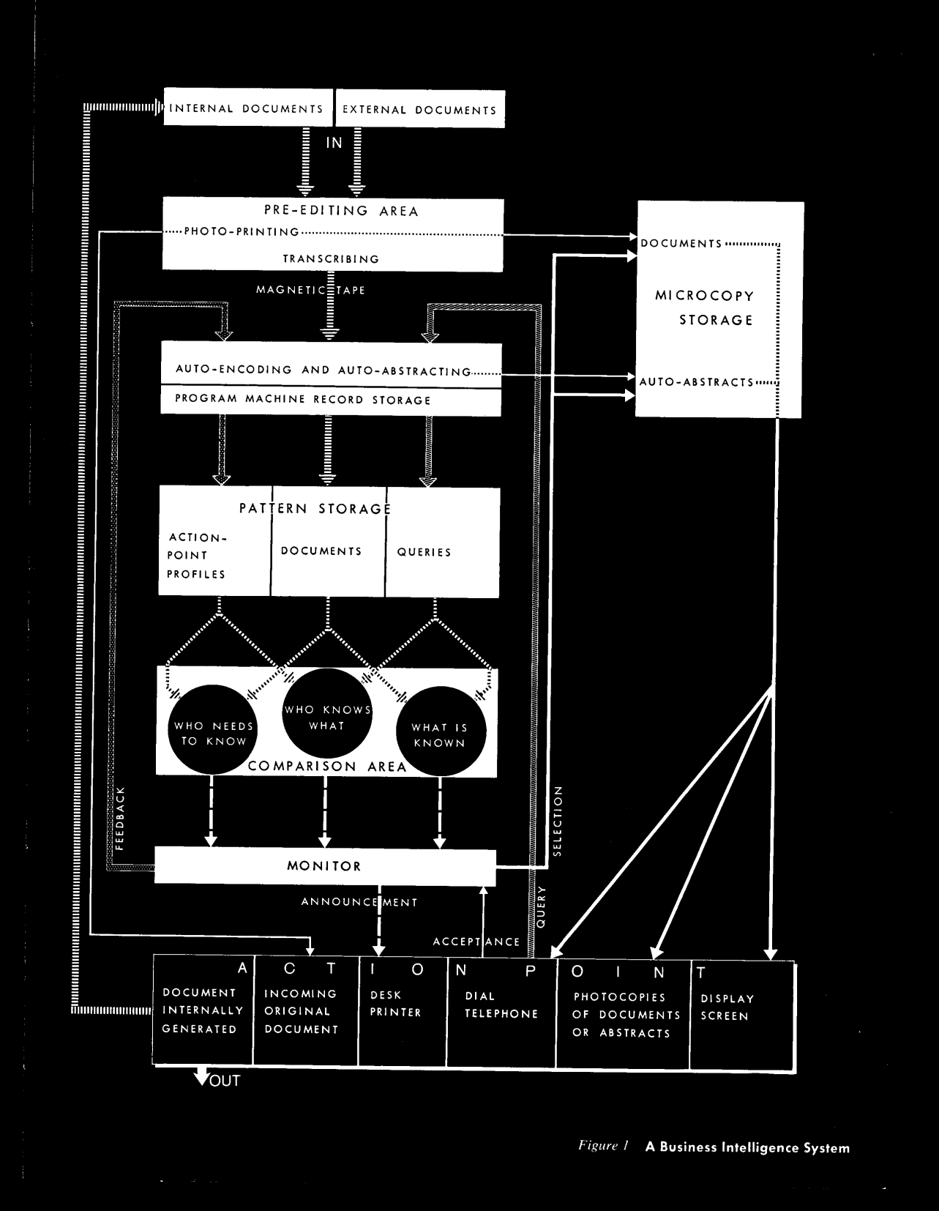

Document input and processing
Knowledge handling is key
Desk Set (1957): Computer engineer Richard Sumner (Spencer Tracy) and television network librarian Bunny Watson (Katherine Hepburn) and the "electronic brain" EMERAC.
H.P. Luhn, “A Business Intelligence System,” IBM Journal, October 1958

Slide 10
Intelligence
Business intelligence (BI) was first defined in 1958:
“In this paper, business is a collection of activities carried on for whatever purpose, be it science, technology, commerce, industry, law, government, defense, et cetera... The notion of intelligence is also defined here... as ‘the ability to apprehend the interrelationships of presented facts in such a way as to guide action towards a desired goal.’”
-- Hans Peter Luhn
“A Business Intelligence System”
IBM Journal, October 1958
Applies to --

Slide 11
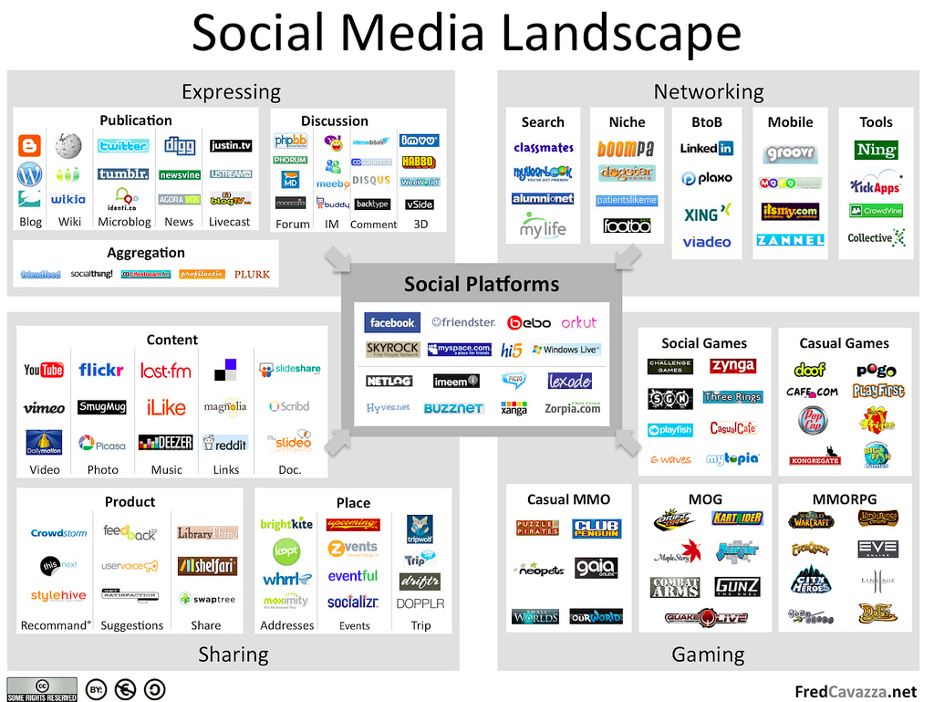
The Popular, Misguided View, 2

Slide 12
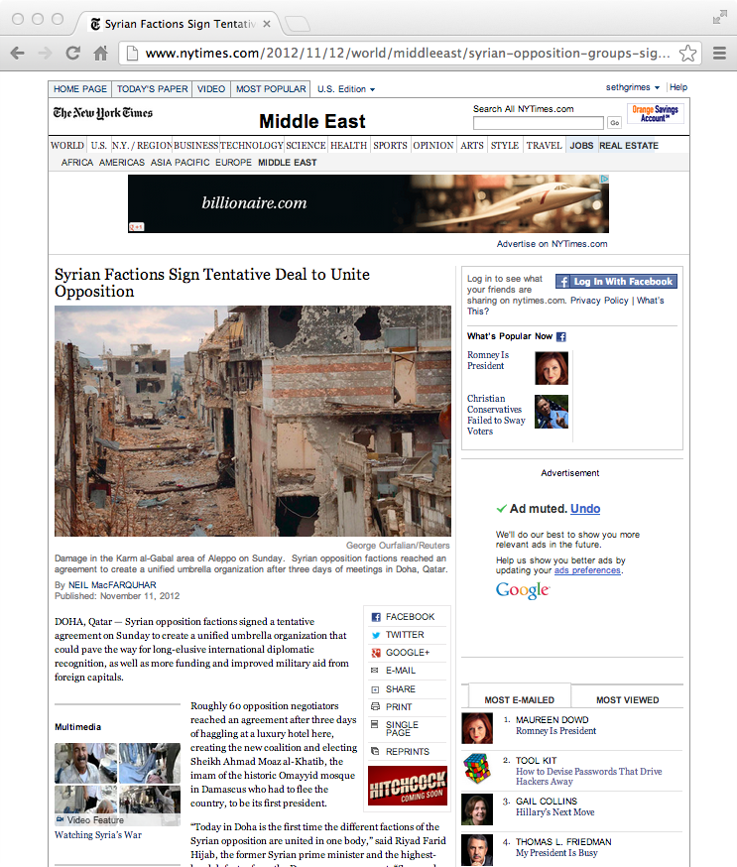
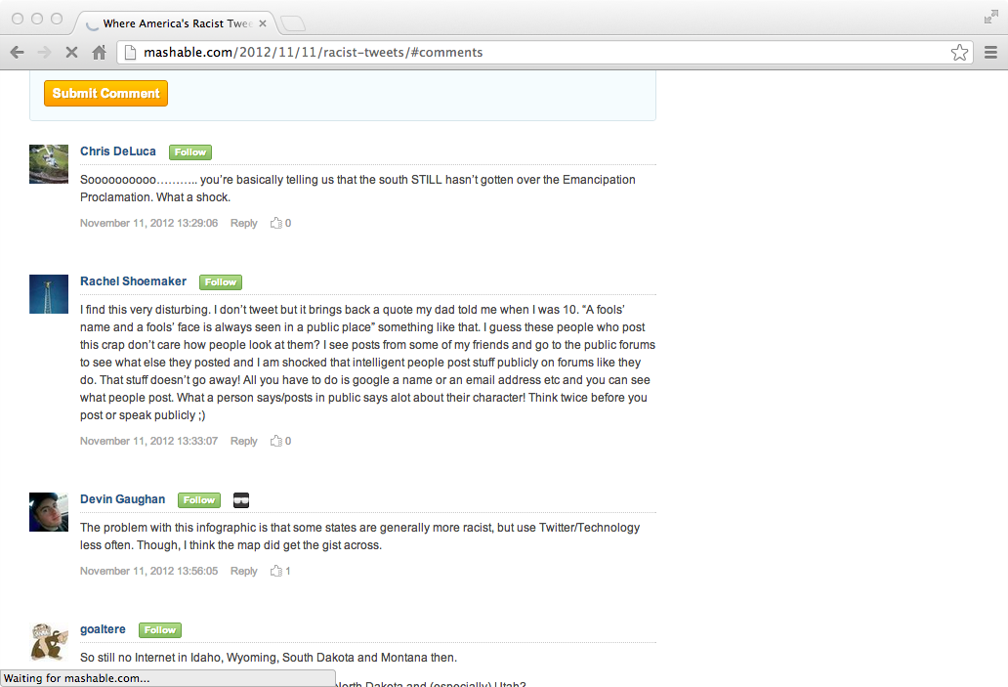
Incomplete!
All media are social.

Slide 13
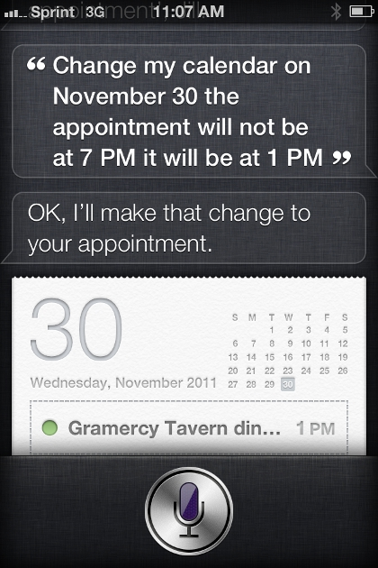
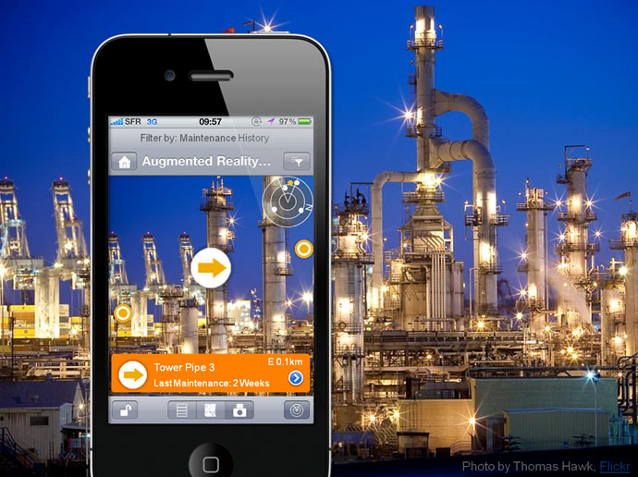
Incomplete, 2
Personal. Mobile. Knowledge Infused.
http://timoelliott.com/blog/2010/10/sap-businessobjects-augmented-explorer-now-available-resources-to-test-it.html

Slide 14
What Is Our Vision? Our Goal?
The inclusion of social data and social-derived insights (a.k.a. information) in a global knowledge network?
The social Semantic Web?
The Semantic Social Web?
Why extract knowledge from social media?
The academic challenge is interesting but not enough.
We want to create better social-computing experiences.
We want to infuse social into other computing realms.

Slide 15
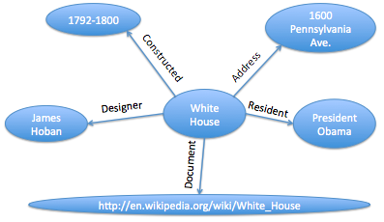
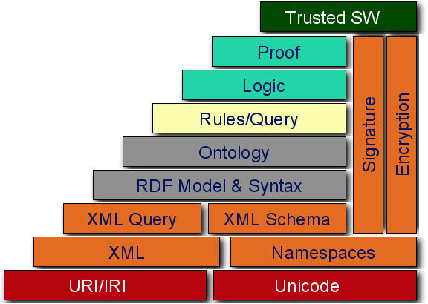
Our Social Knowledge Goal?
http://www.cambridgesemantics.com/semantic-university/semantic-search-and-the-semantic-web
“The Semantic Web has been and remains a parallel, incomplete, never-up-to-date subset of the World Wide Web and the databases accessible through it.” (Me, 2010)
http://img.freebase.com/api/trans/raw/m/02dtnzv

Slide 16
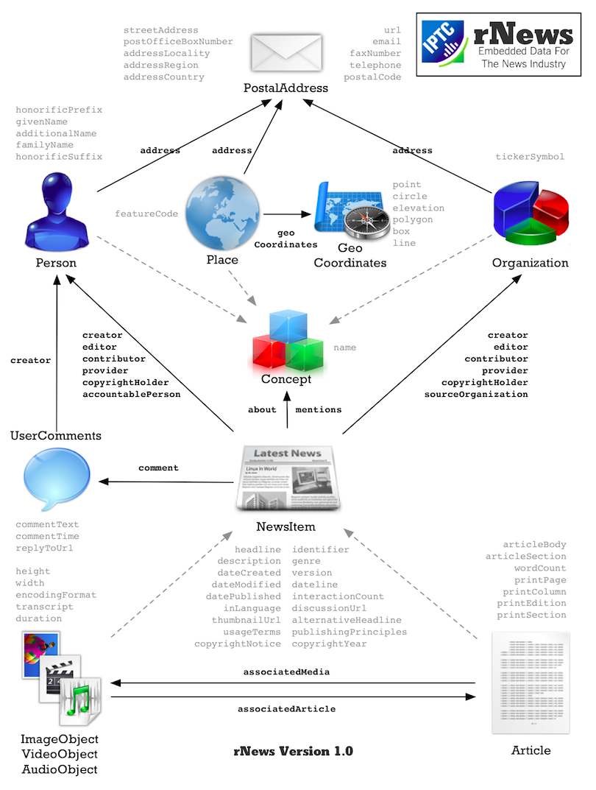
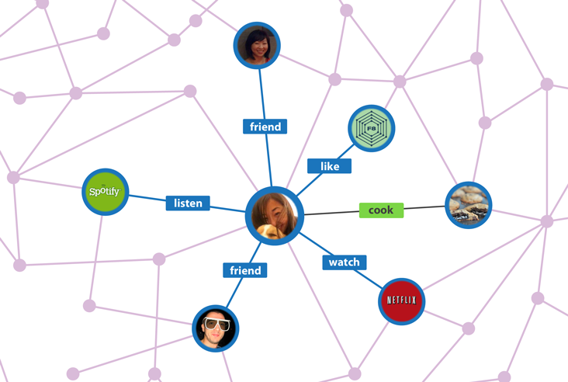
Business Driven Approaches
Pragmatic knowledge structuring.
https://developers.facebook.com/docs/opengraph/
<div itemscope itemtype="http://schema.org/Organization">
<span itemprop="name">Google.org (GOOG)</span>
Contact Details:
<div itemprop="address" itemscope itemtype="http://schema.org/PostalAddress">
Main address:
<span itemprop="streetAddress">38 avenue de l'Opera</span>
<span itemprop="postalCode">F-75002</span>
<span itemprop="addressLocality">Paris, France</span> ,
</div>
Tel:<span itemprop="telephone">( 33 1) 42 68 53 00 </span>,
Fax:<span itemprop="faxNumber">( 33 1) 42 68 53 01 </span>,
E-mail: <span itemprop="email">secretariat(at)google.org</span>
</div>
http://open.blogs.nytimes.com/2012/02/16/rnews-is-here-and-this-is-what-it-means/
http://schema.org/Organization

Slide 17
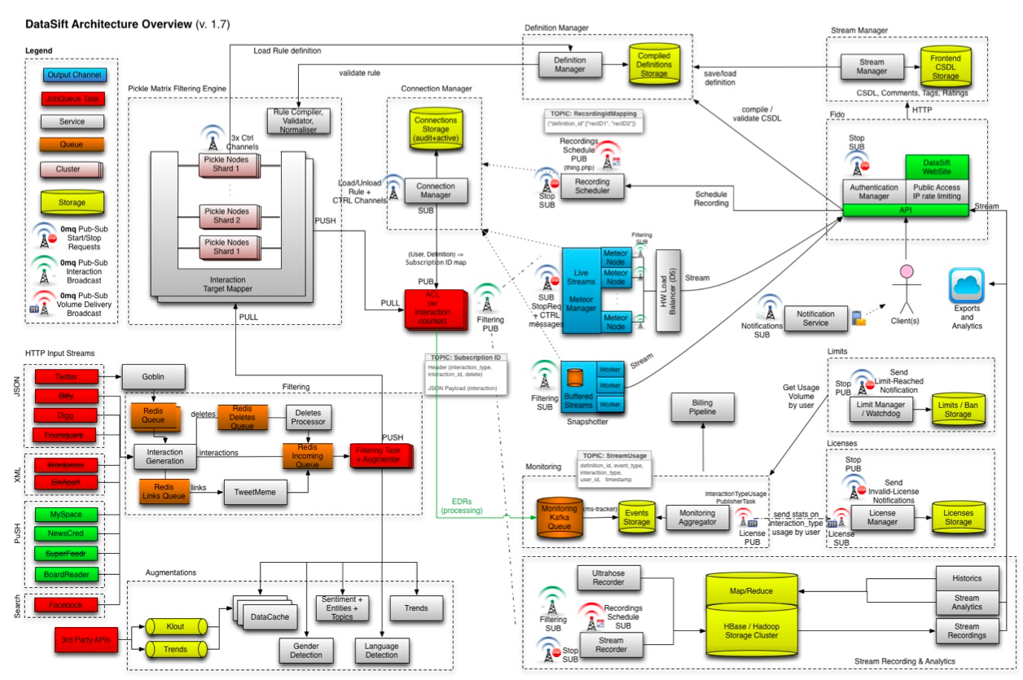
Business Driven Approaches, 2a
Data pipes

Slide 18
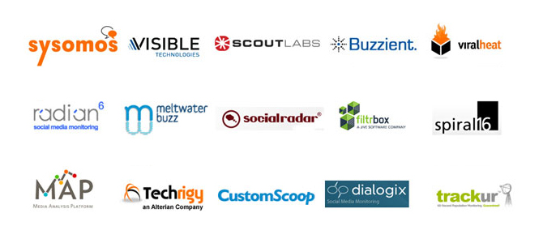
Business Driven Approaches, 3
Social media monitoring.
http://www.goldbachinteractive.com/current-news/technical-papers/social-media-monitoring-a-small-market-overview-sysomos-radian6-and-more

Slide 19
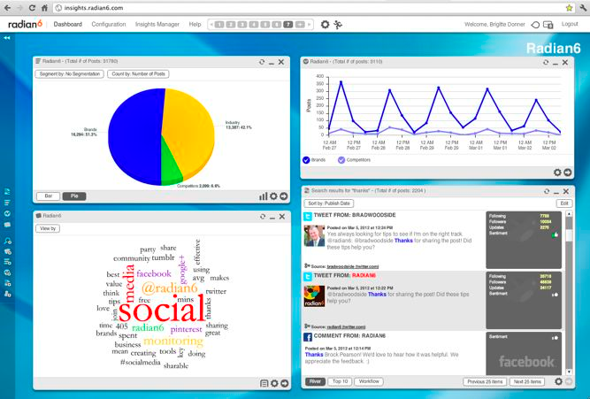
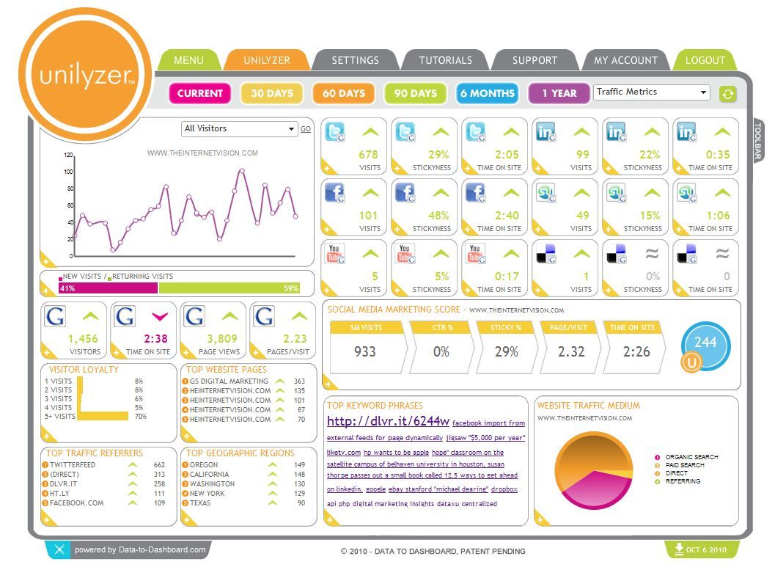
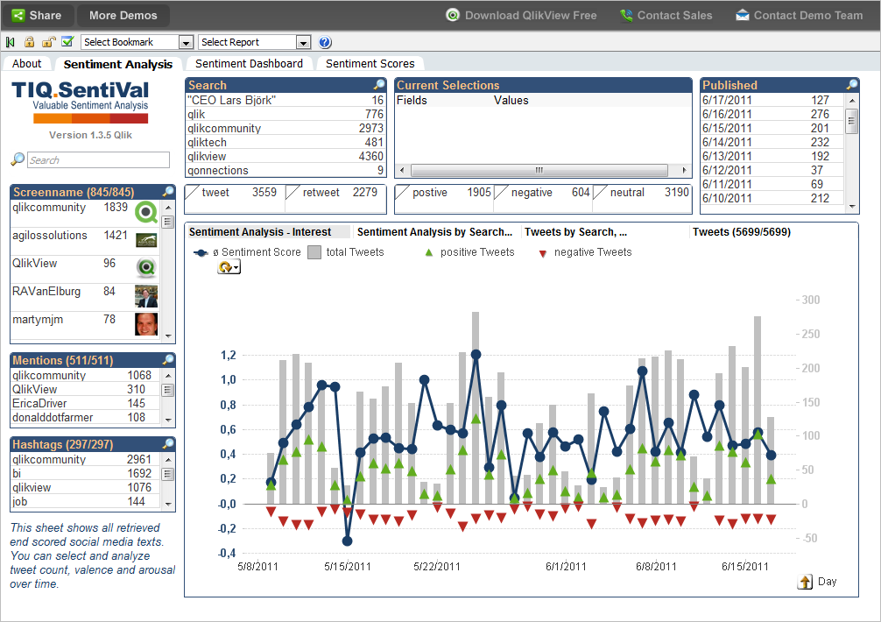
Business Driven Approaches, 3’
Dashboards and engagement consoles.

Slide 20
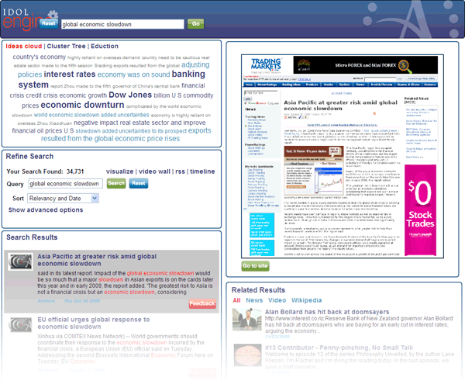
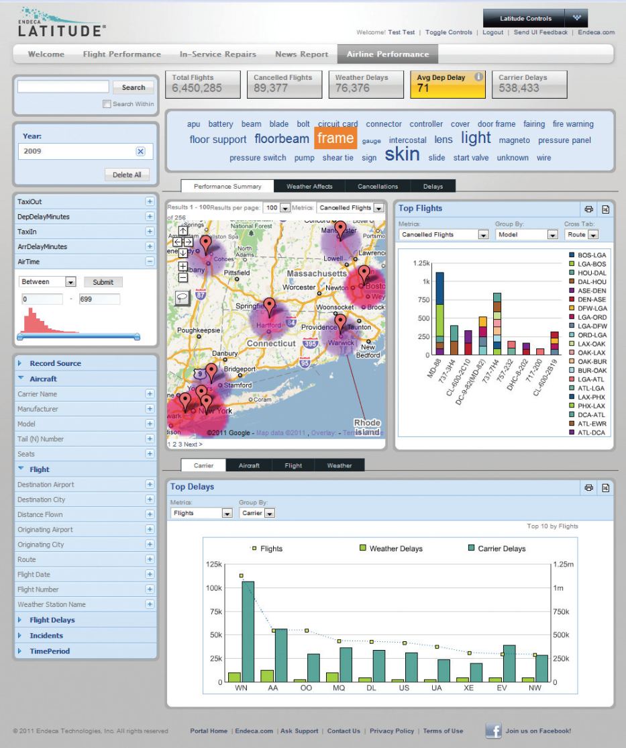

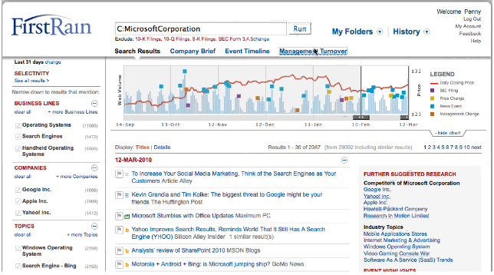
Fusions: Analysis

Slide 21
Business Driven, 4
Infographics: Old wine, new bottles.
− Static, non-collaborative.
+ I like narrative.

Slide 22
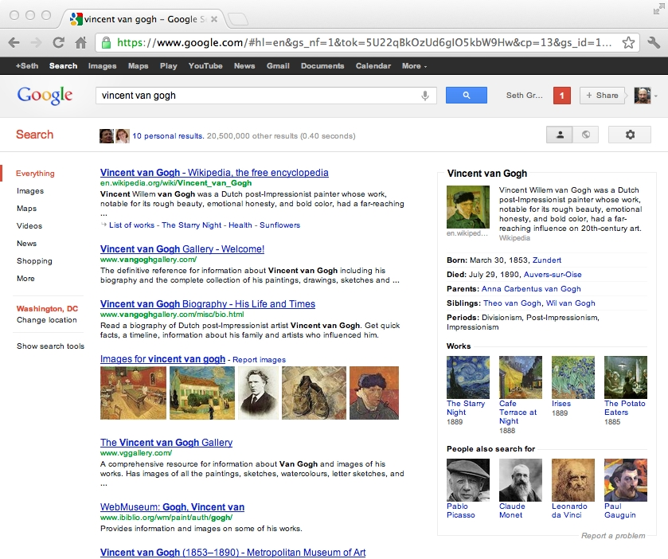
Business Driven Approaches, 5
A Semanticized Web

Slide 23
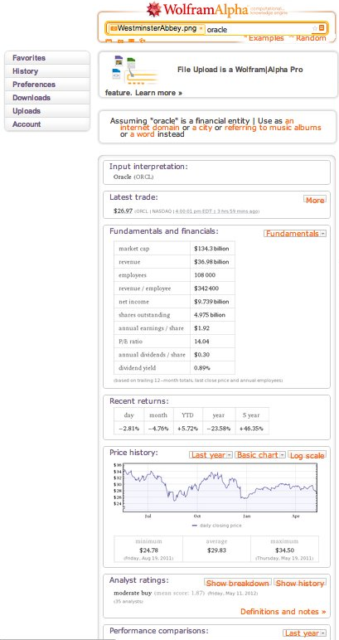
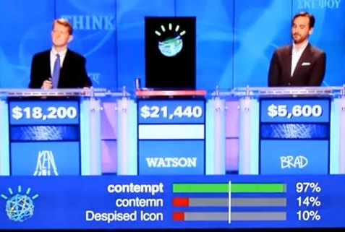
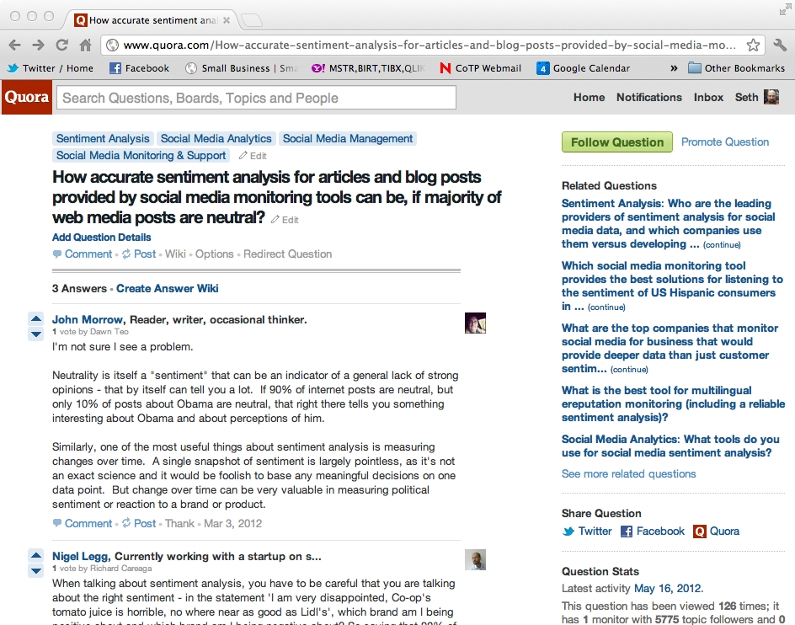
Business Driven, 6
Question Authorities.
https://secure.wikimedia.org/wikipedia/en/wiki/File:Watson_Jeopardy.jpg

Slide 24
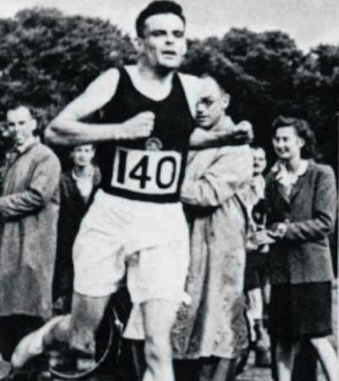
The Race

Slide 25
Milestones
Language+ understanding.
Text, speech, and video.
Narrative, discourse, and argument.
Information extraction.
Knowledge structuring and integration.
Inference; synthesis.
Language generation.
Conversation; interaction; autonomy.
≈> Convergence, a.k.a. Singularity

Slide 26
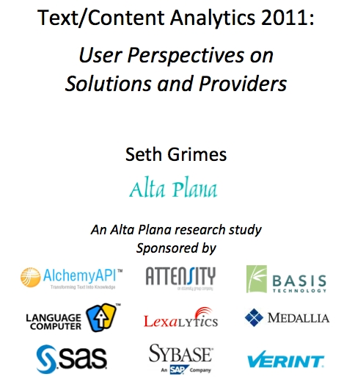
What does the market say?
Free report download via http://altaplana.com/TA2011

Slide 27
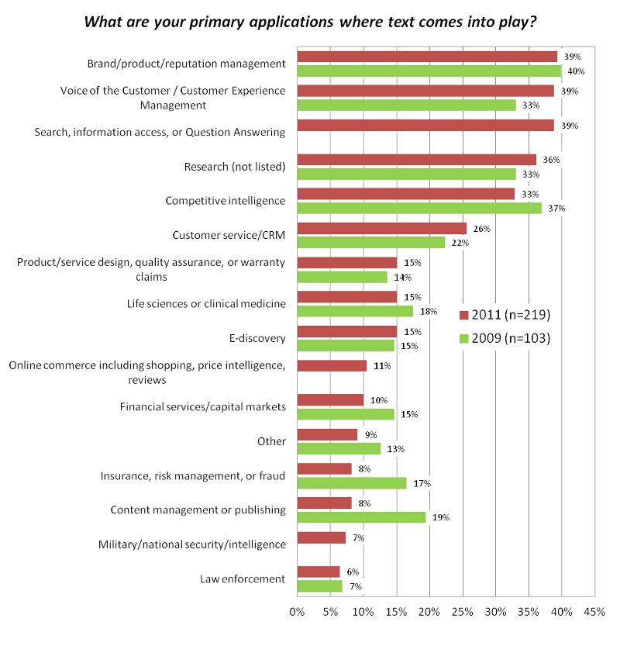
Users (current & potential) say

Slide 28
Important sources
What textual information are you analyzing or do you plan to analyze?
blogs and other social media (twitter, social-network sites, etc.) | 62% (2011) 47% (2009)
news articles | 41% (2011) 44% (2009)
on-line forums | 35% (2011) 35% (2009)
customer/market surveys | 35% (2011) 34% (2009)
reviews | 30% (2011) 21% (2009)
e-mail and correspondence | 29% (2011) 36% (2009)

Slide 29
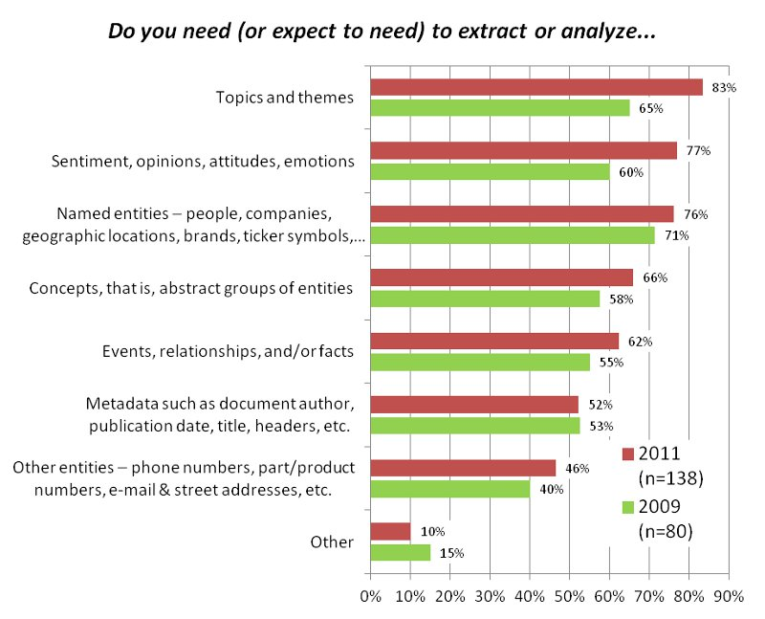
Information in text

Slide 30
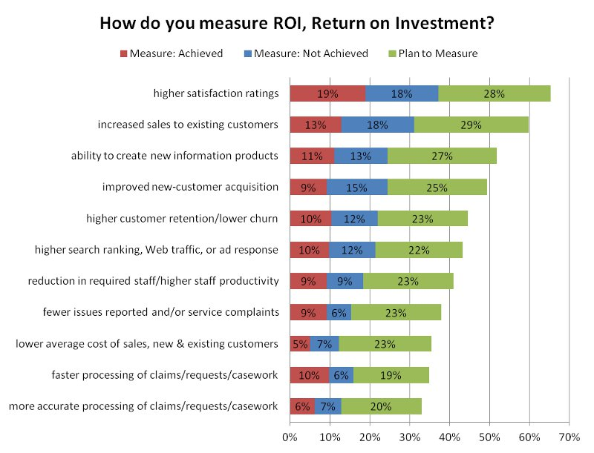

Slide 31
Applications
Text analytics has applications in –
Intelligence & law enforcement.
Life sciences.
Media & publishing including social-media analysis and contextual advertizing.
Competitive intelligence.
Voice of the Customer: CRM, product management & marketing.
Legal, tax & regulatory (LTR) including compliance.
Recruiting.

Slide 32
Online Commerce
Text analytics is applied for marketing, search optimization, competitive intelligence.
Analyze social media and enterprise feedback to understand opportunities, threats, trends.
Categorize product and service offerings for on-site search and faceted navigation and to enrich content delivery.
Annotate pages to enhance Web-search findability, ranking.
Scrape competitor sites for offers and pricing.
Analyze social and news media for competitive information.

Slide 33
Voice of the Customer
Text analytics is applied to enhance customer service and satisfaction.
Analyze customer interactions and opinions –
E-mail, contact-center notes, survey responses.
Forum & blog posting and other social media.
– to –
Address customer product & service issues.
Improve quality.
Manage brand & reputation.
If you can link qualitative information from text you can –
Link feedback to transactions.
Assess customer value.
Understand root causes.
Mine data for measures such as churn likelihood.

Slide 34
E-Discovery and Compliance
Text analytics is applied for compliance, fraud and risk, and e-discovery.
Regulatory mandates and corporate practices dictate –
Monitoring corporate communications.
Managing electronic stored information for production in event of litigation.
Sources include e-mail (!!), news, social media
Risk avoidance and fraud detection are key to effective decision making
Text analytics mines critical data from unstructured sources.
Integrated text-transactional analytics provides rich insights.

Slide 35
Knowledge, Enrichment & Integration
Semantics enables join across types and/or sources and/or structures, using meaningful identifiers, to create an ensemble that is greater than the sum of the parts.
Interrelate information to represent knowledge.
Enrichment and integration involve:
Mappings and transformations.
Aggregation and collection.
All the typical data concerns: cleansing, profiling, consistency, security,…

Slide 36
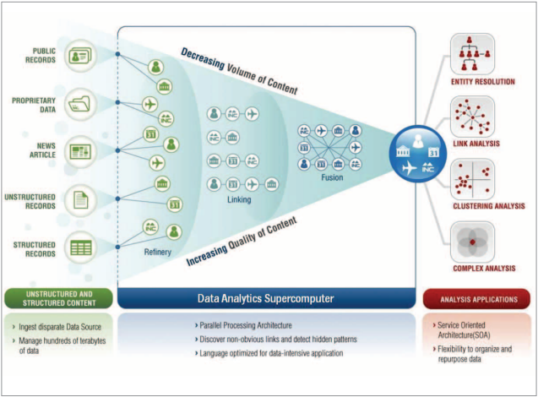
A Big Data analytics architecture (HPCC’s)
http://hpccsystems.com/
http://www.geeklawblog.com/2011/12/lexis-advance-platform-launch-two.html

Slide 37
Text+ Technology Mashups
Text analytics generates semantics to bridge search, BI, and applications, enabling next-generation information systems.
Semantic search (search + text)
Search
BI
Information access (search + text + BI)
Search based applications (search + text + apps)
Applica-tions
Integrated analytics (text + BI)
Text analytics (inner circle)
NextGen CRM, EFM, MR, marketing, …

Slide 38

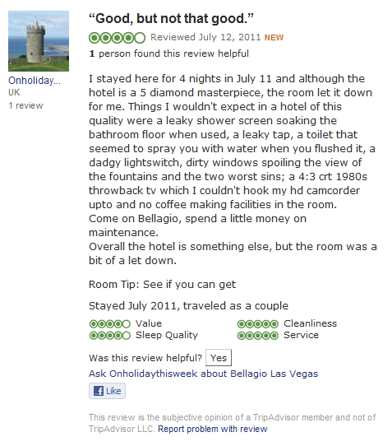
Social Sources
Dealing with social sources requires flexibility, data/content sophistication, and timeliness.

Slide 39
Sentiment Analysis
“Sentiment analysis is the task of identifying positive and negative opinions, emotions, and evaluations.”
-- Wilson, Wiebe & Hoffman, 2005, “Recognizing Contextual Polarity in Phrase-Level Sentiment Analysis”
“Sentiment analysis or opinion mining is the computational study of opinions, sentiments and emotions expressed in text… An opinion on a feature f is a positive or negative view, attitude, emotion or appraisal on f from an opinion holder.”
-- Bing Liu, 2010, “Sentiment Analysis and Subjectivity,” in Handbook of Natural Language Processing

Slide 40
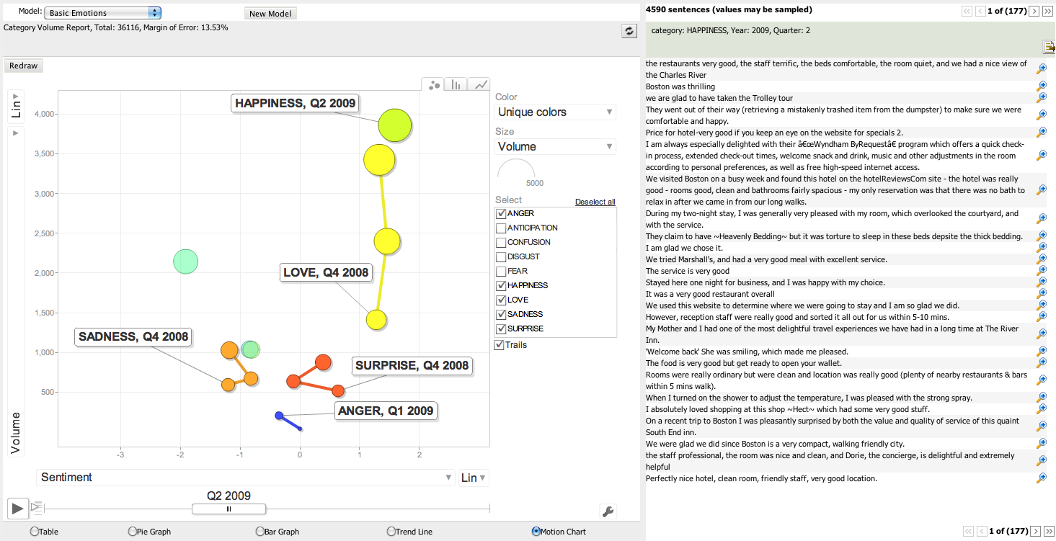
Beyond Polarity

Slide 41


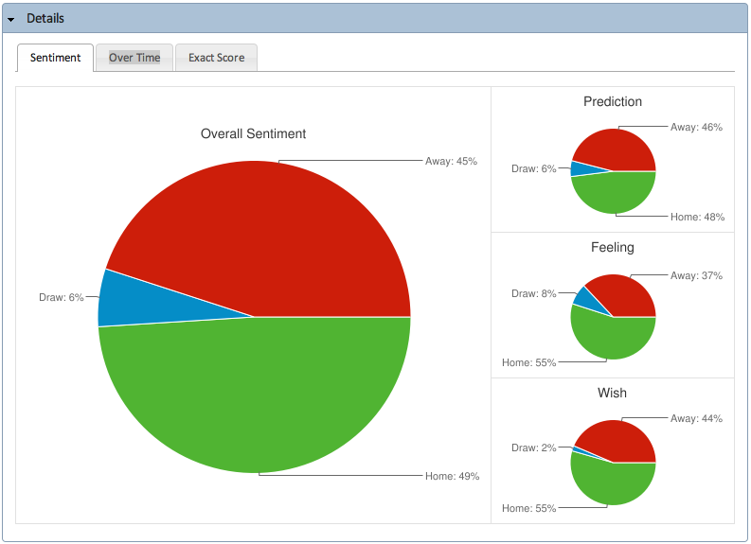
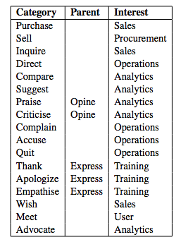
Intent Analysis
http://sentibet.com/
http://www.aiaioo.com/whitepapers/intention_analysis_use_cases.pdf

Slide 42
Complications
Sentiment may be of interest at multiple levels.
Corpus / data space, i.e., across multiple sources.
Document.
Statement / sentence.
Entity / topic / concept.
Human language is noisy and chaotic!
Jargon, slang, irony, ambiguity, anaphora, polysemy, synonymy, etc.
Context is key. Discourse analysis comes into play.
Must distinguish the sentiment holder from the object:
“Geithner said the recession may worsen.”

Slide 43
Milestones Re-viewed
✔ Language+ understanding.
Text, speech, and video.
✖ Narrative, discourse, and argument.
✔ Information extraction.
✔ Knowledge structuring and integration.
? Inference; synthesis.
Language generation.
Conversation; interaction; autonomy.
≈> Convergence, a.k.a. Singularity

Slide 44
Text Tech Initiatives
Now and near future.
Broader & deeper international language support.
Sentiment analysis, beyond polarity.
Emotions, intent signals. etc.
Identity resolution & profile extraction.
Online-social-enterprise data integration.
Semantic data integration, Complex Data.
Speech analytics.
Discourse analysis.
Because isolated messages are not conversations.
Rich-media content analytics.
Augmented reality; new human-computer interfaces.

Slide 45
A Focus on Information & Applications
Now and near future.
Signal detection.
Sentiment, emotion, identity, intent.
Semanticized applications.
Linkable, mashable, enrichable.
Rich information.
Context sensitive, situational.
Σ = Sense-making…

Slide 46
Primary Solution Considerations
Adaptation or specialization: To a business or cultural domain, information type (e.g., text, speech, images) & source (e.g., Twitter, e-mail, news articles).
By-user customization possibilities: For instance, via custom taxonomies, rules, lexicons.
Sentiment resolution: Aggregate, message, or feature level. (What features? Topics, coreferenced entities?)

Slide 47
Primary Considerations, cont.
Outputs: E.g., annotated text, models, indicators, dashboards, exploratory data interfaces.
Usage mode: As-a-service (via API) or installed/hosted/cloud.
Capacity: Volume, performance, throughput.
Cost.

Slide 48
Software & Platform Options
Text-analytics options may be grouped generally.
Installed text-analysis application, whether desktop or server or deployed in-database.
Data mining workbench.
Hosted.
Programming tool.
As-a-service, via an application programming interface (API).
Code library or component of a business/vertical application, for instance for CRM, e-discovery, search.
Text analytics is frequently embedded in search or other end-user applications.

Slide 49
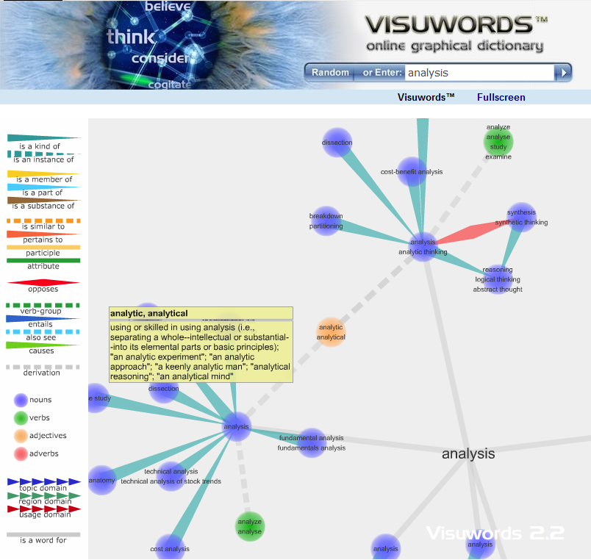



Analytical Assets (Open Source)
>>> import nltk
>>> sentence = """At eight o'clock on Thursday morning... Arthur didn't feel very good."""
>>> tokens = nltk.word_tokenize(sentence)
>>> tokens
['At', 'eight', "o'clock", 'on', 'Thursday', 'morning',
'Arthur', 'did', "n't", 'feel', 'very', 'good', '.']
>>> tagged = nltk.pos_tag(tokens)
>>> tagged[0:6]
[('At', 'IN'), ('eight', 'CD'), ("o'clock", 'JJ'), ('on', 'IN'),
('Thursday', 'NNP'), ('morning', 'NN')]
http://nltk.org/
tm: Text Mining Package
A framework for text mining applications within R.

Slide 50
Providers 1 (non-exhaustive) –
Human analysis.
Converseon (to date).
KD Paine Associates.
Synthesio.
Human crowdsourced:
Amazon Mechanical Turk.
CrowdFlower.

Slide 51
Providers 2 (non-exhaustive) –
As-a-service:
AlchemyAPI.
Converseon ConveyAPI.
OpenAmplify.
Saplo.
Software libraries:
GATE
LingPipe.
Python NLTK.
R.
RapidMiner.

Slide 52
Providers 3 (non-exhaustive) –
Financial markets applications.
Digital Trowel.
Dow Jones.
RavenPack.
Thomson Reuters NewsScope.

Slide 53
Providers 4 (non-exhaustive) –
Other-domain applications.
Attensity. Clarabridge.
Crimson Hexagon. Expert System.
IBM. Kana/Overtone.
Lexalytics. Medallia.
NetBase. OpenText/Nstein.
SAP. SAS.
Sysomos. WiseWindow.

Slide 54
Who’s Doing What for Whom, and How? The Social Media Analysis Solution Space
Seth Grimes
@sethgrimes

